Slide 1
Equitable Attainment of Engineering Degrees:
A Tri-University Proposal & Improvement Effort
University of Arizona
University of California-San Diego
Georgia Institute of Technology

Slide 2
Why Does This Matter?
Societal Imperative. Engineering occupations are among the highest-paying and most prestigious in the US labor market, but also some of the least diverse.
Solution Quality. Engineered solutions created by diverse teams are better.
Federal Funding Opportunities/Priorities. Very much aligned with “inclusive innovation” and “rise of the rest.”
National Competitiveness. An increasing supply of engineering graduates is necessary to sustain the US innovation enterprise, global competitiveness, and national security.

Slide 3
Study Questions
Study will involve:
Comparing/contrasting curricular complexities and instructional design issues across the three participating schools
Disciplinary-based workshops and improvement conversations around the findings generated by this work.
Research questions:
How do various engineering disciplines differ regarding the curriculum and instruction they tend to offer (between and within disciplines)?
How do these differences impact time-to-degree and student wellbeing across student demographic groups?
Are there systemic inequities built into programmatic areas due to curricular structure and/or instructional design?

Slide 4
Curricular Complexity
Curricular complexity measures the ease with which students may progress through a curriculum towards graduation.
Reducing curricular complexity increases the likelihood of on-time graduation.
A function of two independent components:
Curricular Complexity = Structural Complexity + Instructional Complexity
Instructional complexity – how you teach and support the instruction provided within a curriculum.
Structural complexity – how you structure your curriculum.

Slide 5
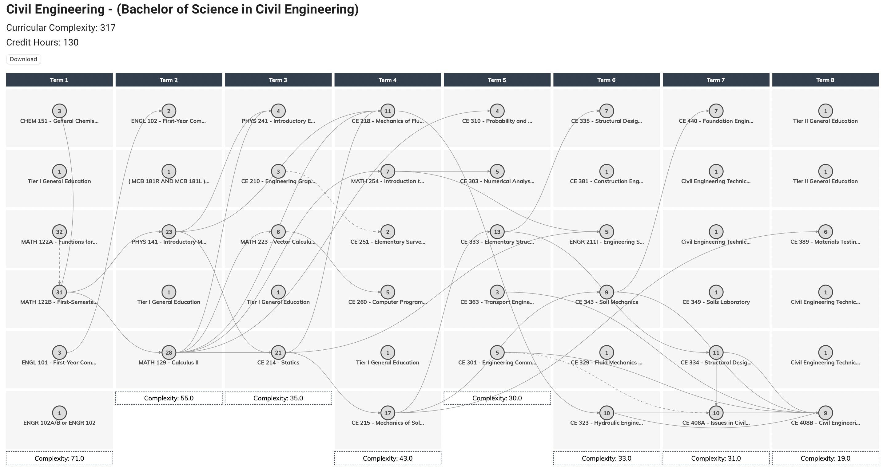
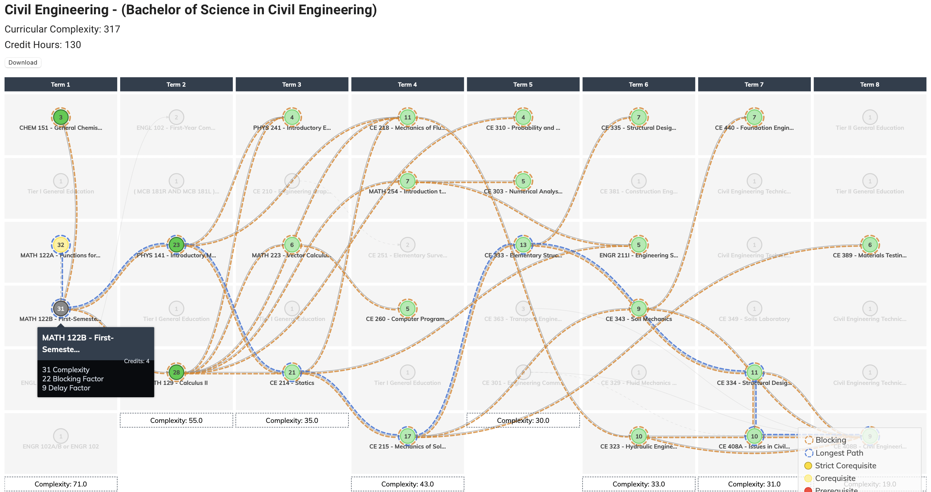
Structural Complexity

Slide 6
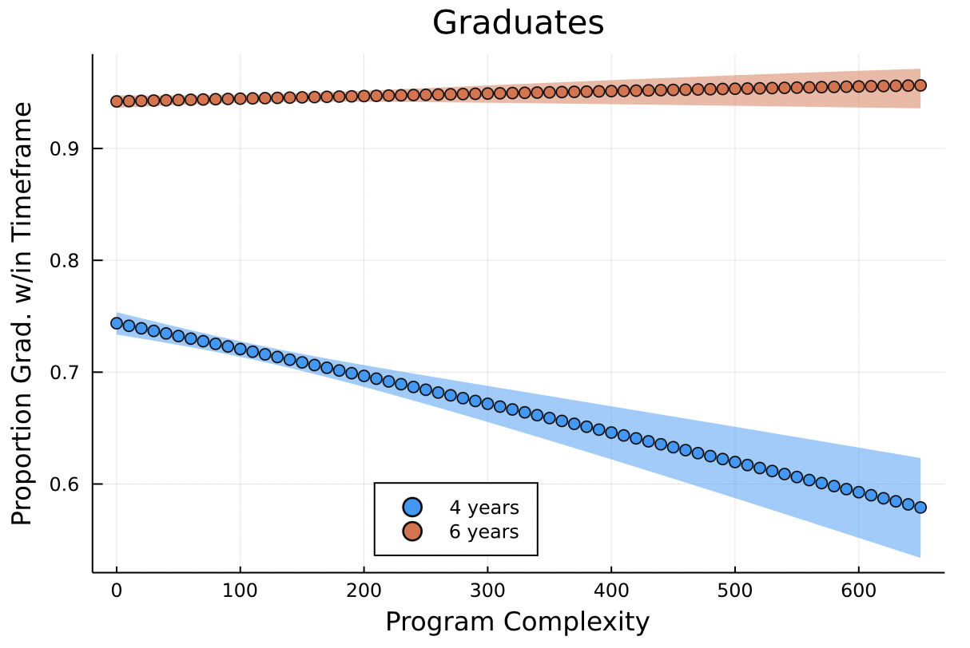
Curricular Complexity and Time-to-Degree
University of Arizona

Slide 7
Study Principles
Collaborative: Facilitate a multi-institutional taskforce-based improvement effort focused on the role that curriculum and instruction play in engineering student success.
Discipline Focused: Using an asset-based approach, leverage disciplinary expertise and best practices at three participating institutions.
Student Centered: Foster reflection on engineering curricula and instruction, possibly leading to reforms producing improved student success outcomes, in alignment with our strategic plans.

Slide 8
Study Design
Data Collection:
- Curricula from engineering programs at home institutions
- Curricula from same programs at peer institutions
- Student progress data (FERPA applies)
Analyses:
- Inter-university curricular and instructional comparisons
- Impact of various student factors on degree-specific progression
- Common curricular patterns (or anti-patterns) and instructional practices in engineering disciplines, as well as the intersection of these two factors
Improvement Framework:
- Development of discipline-specific curricular/instructional best practices
- Design patterns that improve learning outcomes and time-to-degree
- A framework for improving equity in engineering outcomes

Slide 9




















Comparison Institutions (20)

Slide 10
Disciplines Under Review
For each of these initial five disciplines, we have collected preliminary curricula from the three participating institutions, as well as from the 17 other comparison institutions:
Aerospace Engineering
Chemical Engineering
Civil Engineering
Electrical Engineering
Mechanical Engineering
We have initial analyses of curricular complexity, dead-end courses, extraneous prerequisites, etc. for each of these programs.

Slide 11
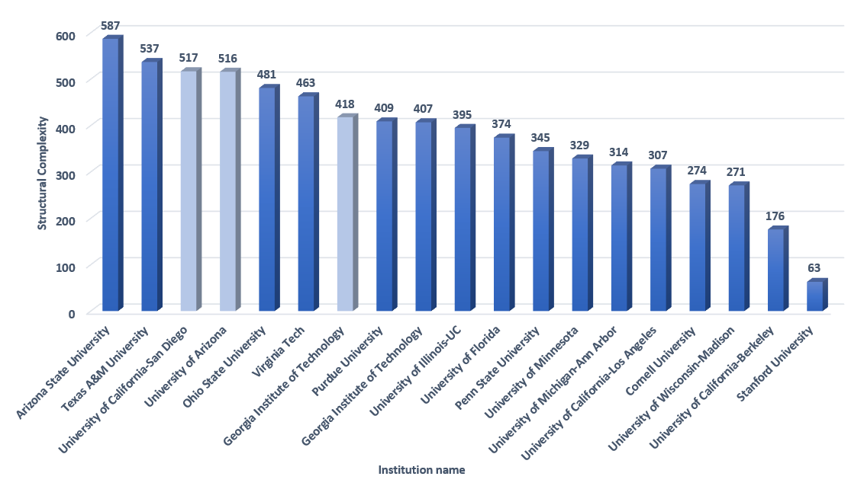
Aerospace Engineering
Notes:
UC San Diego data based on Sixth College

Slide 12
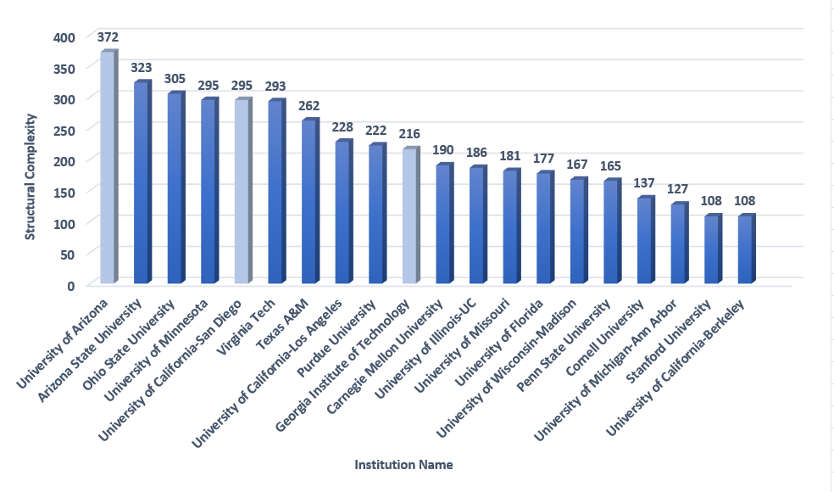
Civil Engineering

Slide 13
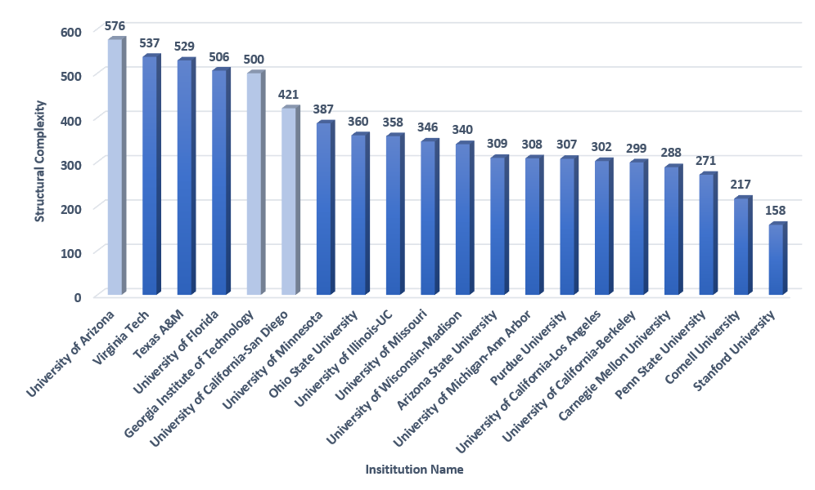
Chemical Engineering

Slide 14
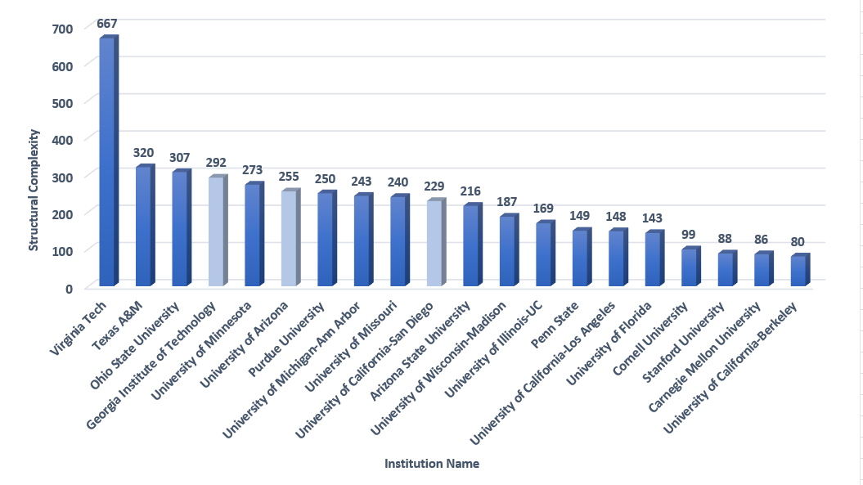
Electrical Engineering

Slide 15
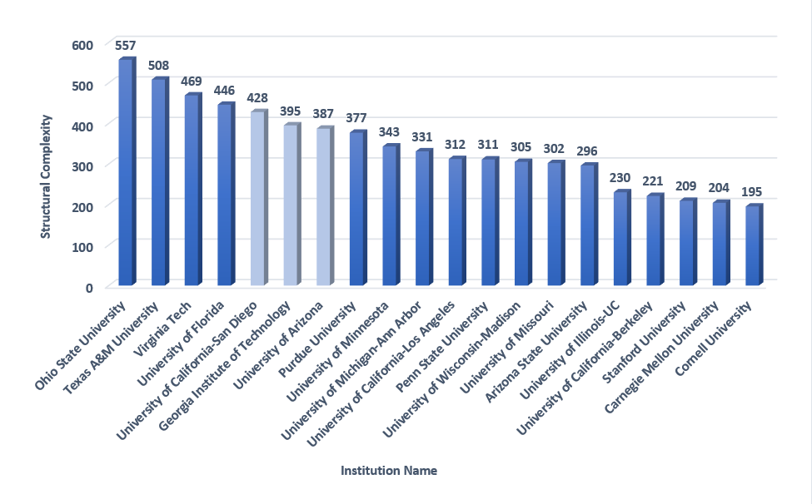
Mechanical Engineering

Slide 16
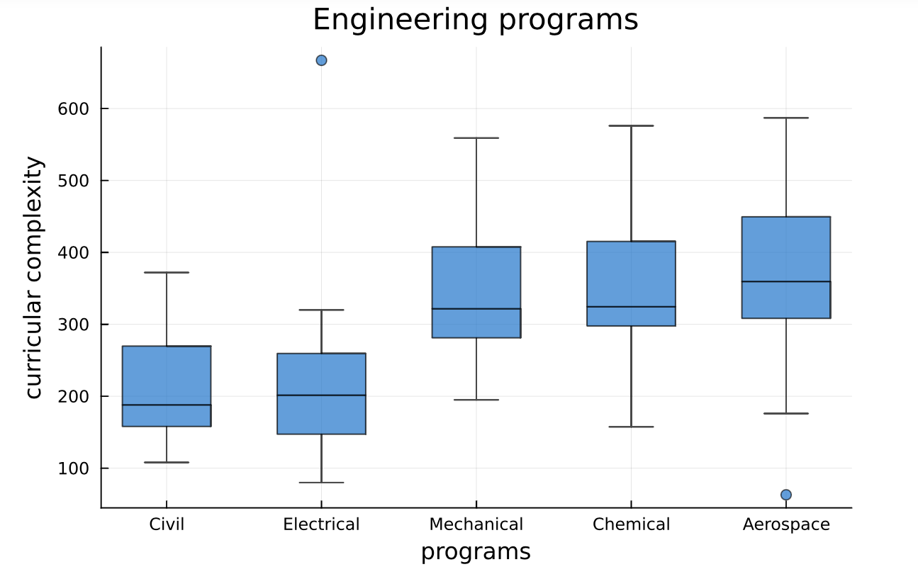
Complexity Differences Between Disciplines

Slide 17
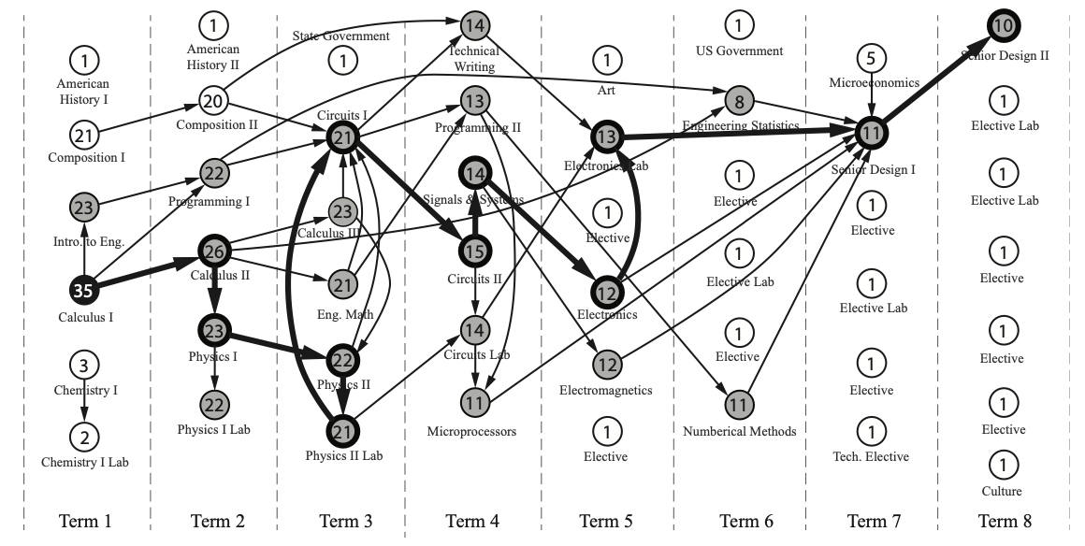
EE Curriculum I – High Structural Complexity

Slide 18
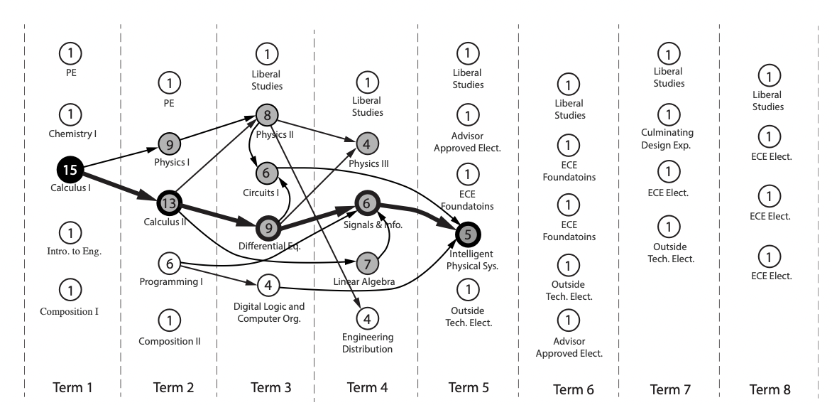
EE Curriculum II – Low Structural Complexity
Notes:
Summary: Greg

Slide 19
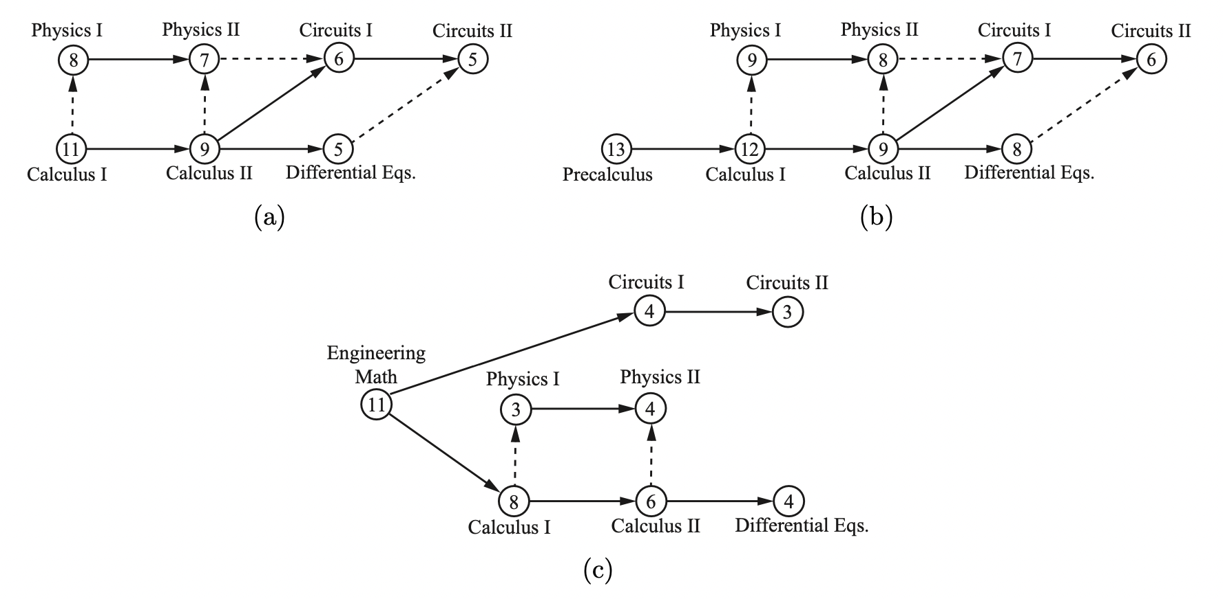
EE Curricular Redesign → 51 → 72 → 43
Notes:
Complexity need to be added

Slide 20
Success Requirements
Buy-in
Academic affairs, college of engineering, and programs at each university (completed)
Collaboration between institutions
Discipline-driven (i.e., by those who “own” the curriculum), supported but not directed by administration
Steps and Timeline
Data collection and preliminary analyses (completed)
Remote kick-off meeting: institutional charge (Dec)
Remote pairing and sharing by discipline (Dec-Feb)
In person meeting: preliminary results and next steps (Mar-Apr)
Implementation/assessment/impact/funding to scale

Slide 21
Questions?

